Slide 1
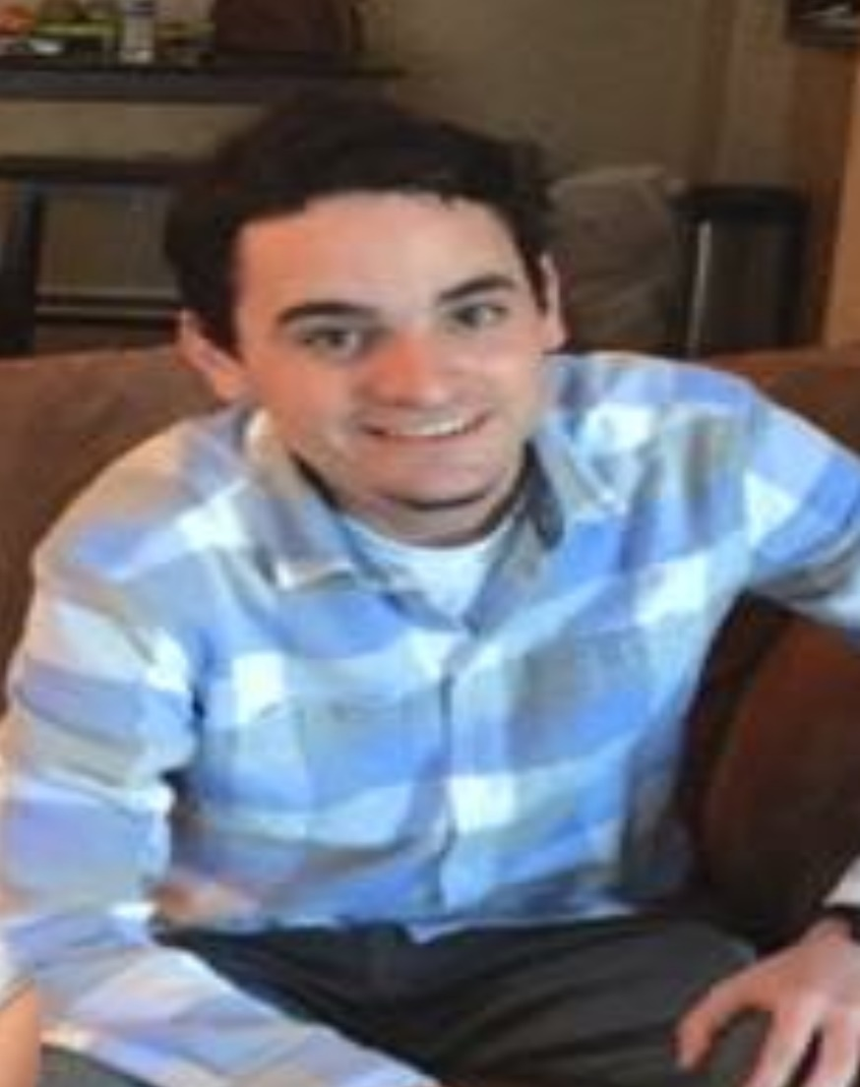
1st Annual Scott Morgan Memorial Bass Tournament
Tournament Director:
Daniel Douglas
256-694-9689
Call to Register
*If you can not make the tournament but would like to make a donation to Wellstone in Scott’s name please contact Daniel Douglas
Saturday August 20th on Lake Guntersville (Waterfront Bay)
Safe light until 2pm
Entry Fee: $50 Per Boat
$10 Big Fish
3 fish tournament (15 inch limit)
90% Payback (10% will be donated off the top to Wellstone in Scott’s honor)
Guides and Tour Pro’s Welcome

